Slide 1
Welcome to the 2026 Great Plains Food Bank Annual Convening

Slide 2
Housekeeping and Overview of Morning
Welcome & Setting the Stage
Programs & Partner Network Updates
Great Plains Food Bank Website Overview, Resources, Tools, & Leading Practices (Guest Speakers: Hope Olsen and Stephanie Erickson)
Break
Feedback Discussion: Food Movement Survey
Agency of the Year, Raffle, and Closing

Slide 3
Harvesting Hope Capital Campaign
Meet Ann Prifrel, New CEO of Great Plains Food Bank!
Learn from Ann Prifrel about the Harvesting Hope Capital Campaign.

Slide 4

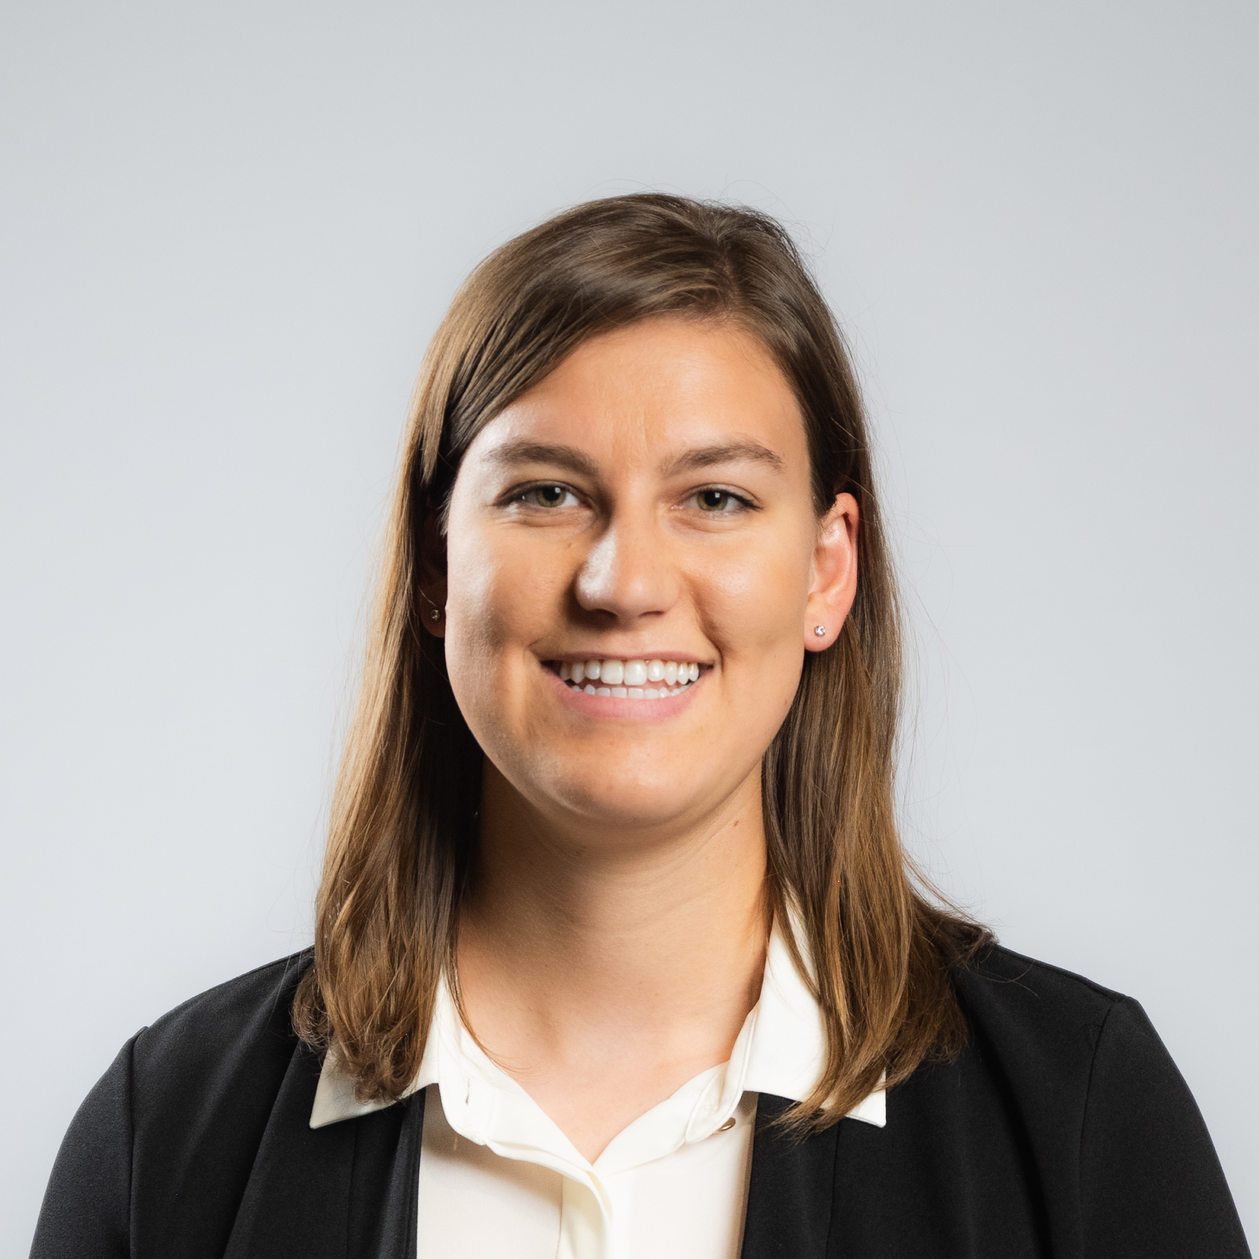

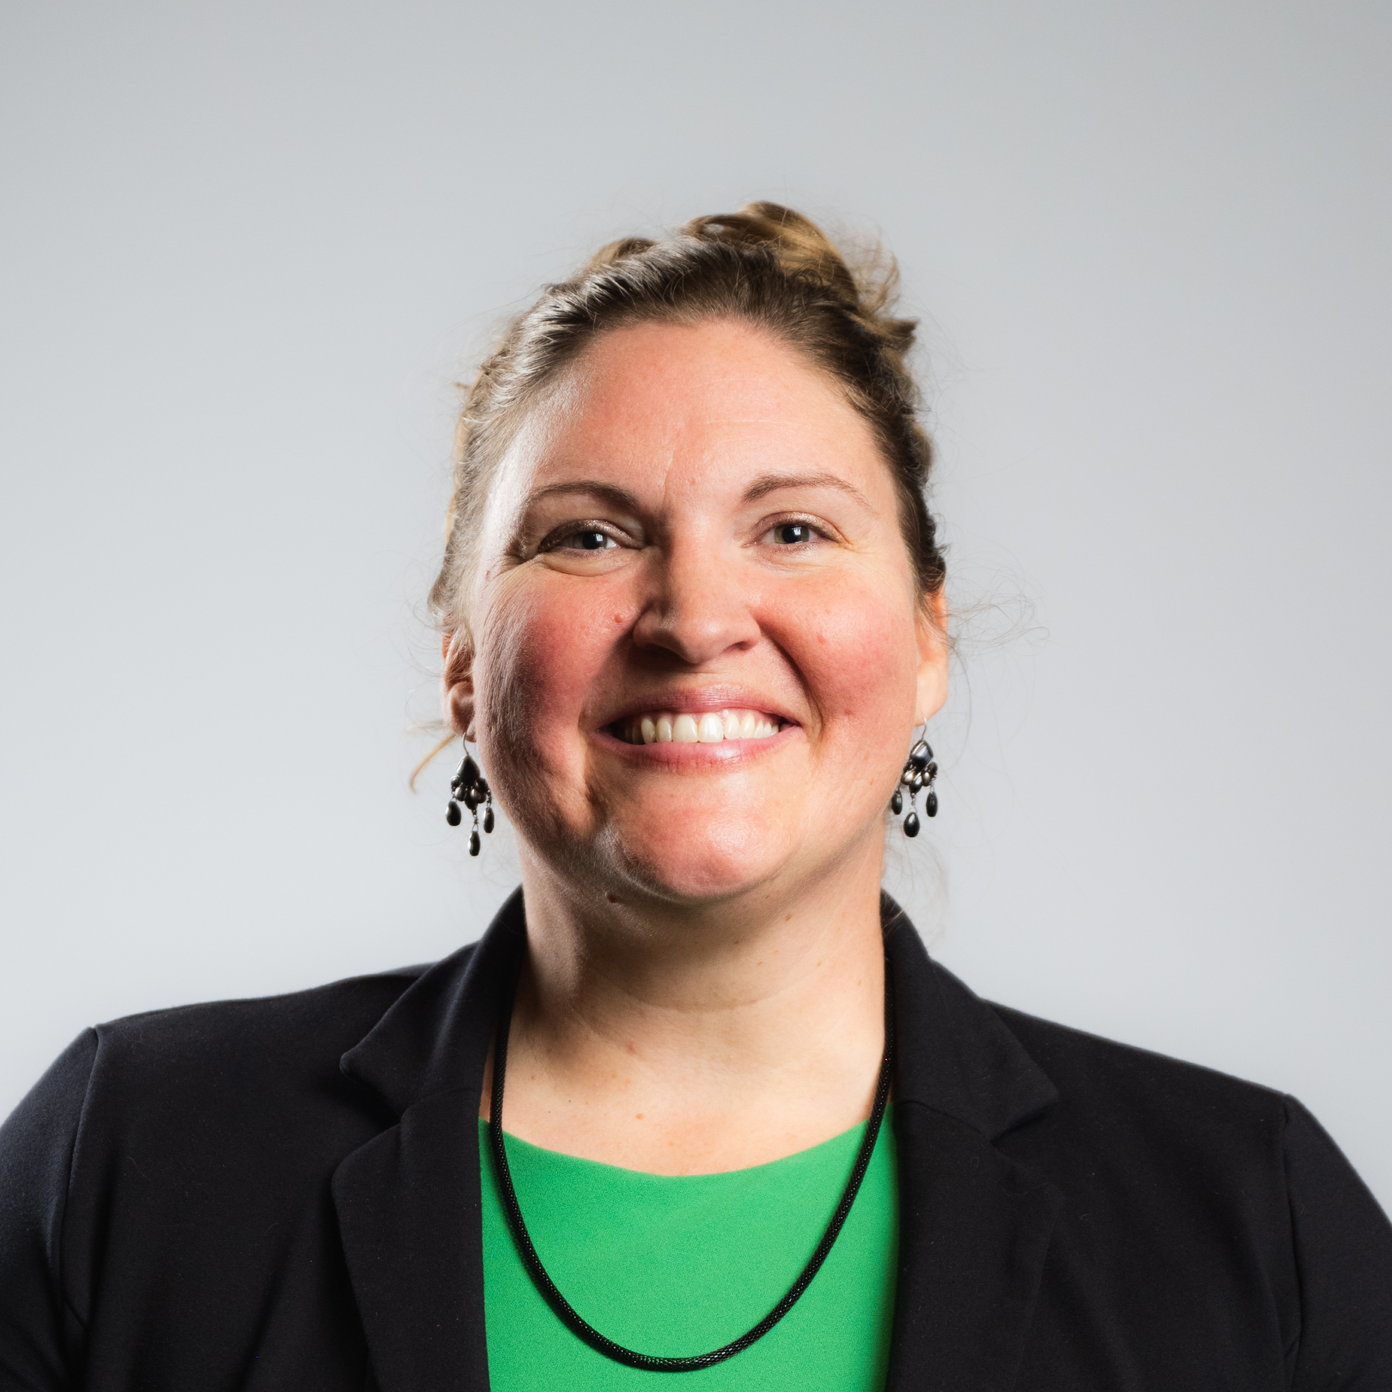

Meet the Team :
Alissa Finke
Kayla Beck
Lora Stone
Janelle LaCoursiere
Ann Prifrel
(CEO)

Slide 5
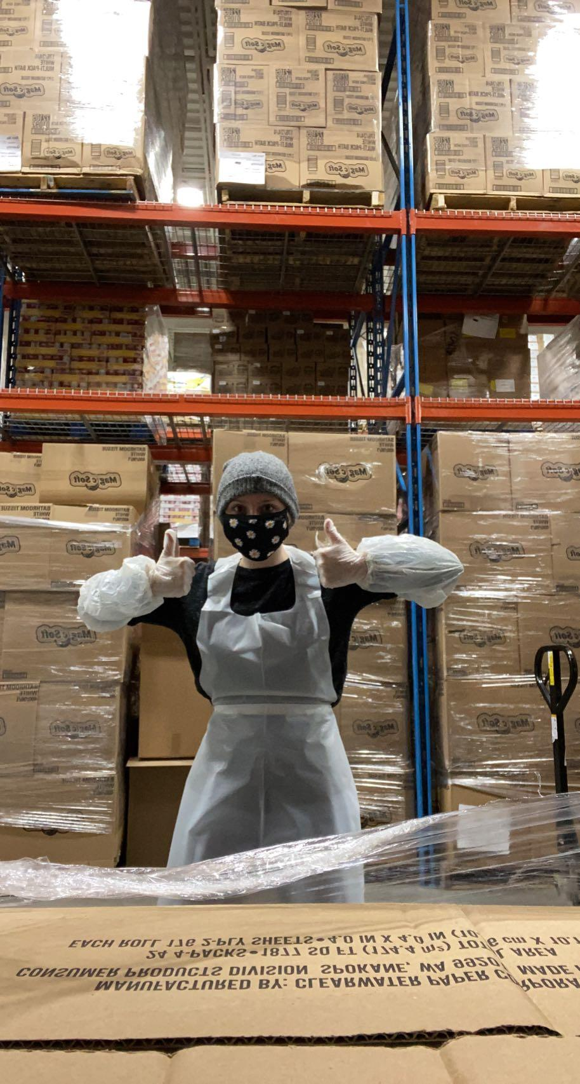
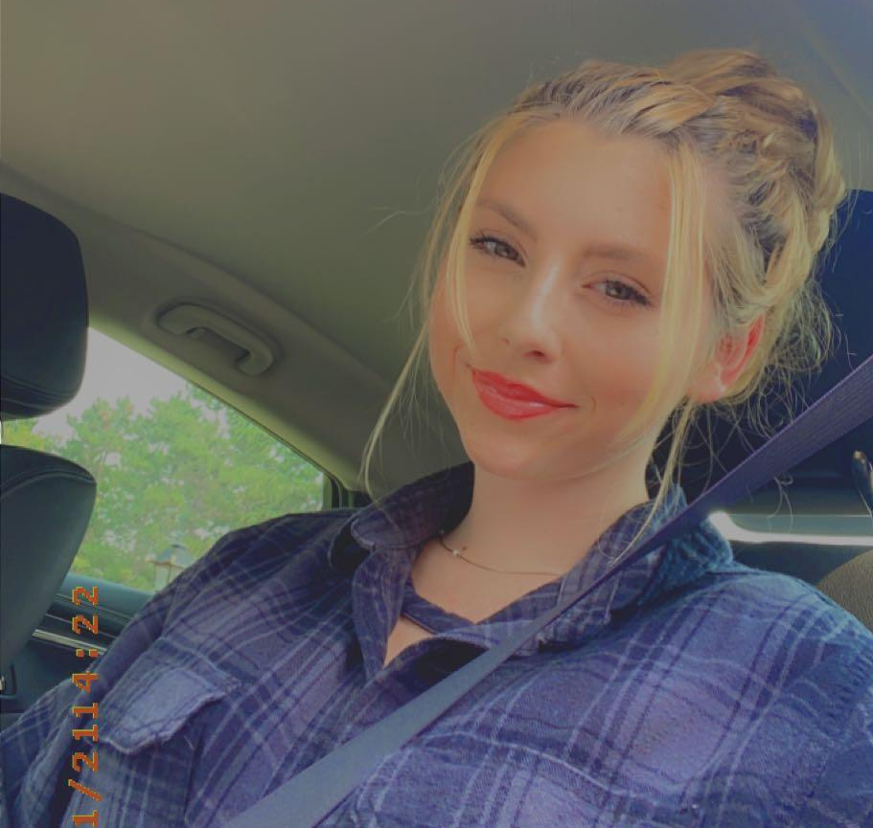
Alissa Finke - Partner Network Specialist (Eastern North Dakota)
Alissa joined Great Plains Food Bank in April 2025. She brings a strong professional background in psychology, psychiatry, and crisis management, with experience supporting vulnerable individuals and children. Additionally, she has worked as a martial arts instructor and in childcare settings, further developing her skills in mentorship and youth engagement. Alissa earned her Associate of Arts and Associate of Science in Applied Psychology from Itasca Community College and her Bachelor of Arts in Applied Psychology from the University of Wisconsin–Superior.
She enjoys training, exploring the arts, and collaborating with others.
Contact Information:
Email: afinke@greatplainsfoodbank.org
Phone: 701-997-7286

Slide 6
Kayla Beck - Partner Network Specialist (Western North Dakota)
Kayla joined Great Plains Food Bank in November of 2021. She currently serves as the partner network specialist on the West Side of the state and offices out of the Bismarck Regional Service Center.
She holds her master’s degree in Social Work, loves plants and her kitty cat.
Kayla could not join us today as she is on leave until June 1, 2026.
Contact Information:
Email: kbeck@greatplainsfoodbank.org
Phone: 701-390-2513

Slide 7

Lora Stone – Programs and Operations Compliance Manager
Lora Stone joined Great Plains Food Bank in December 2025 as Programs and Operations Compliance Manager. She brings more than 25 years of experience in food safety and quality in food manufacturing, supporting compliance, partner programs, and safe food distribution. Lora holds a degree in Food Science with a minor in Food Safety from North Dakota State University.
In addition to her professional work, she teaches yoga and mindfulness and is always expanding her knowledge in health and wellness.
Contact Information:
Email: lstone@greatplainsfoodbank.org
Phone: 701-476-9113

Slide 8
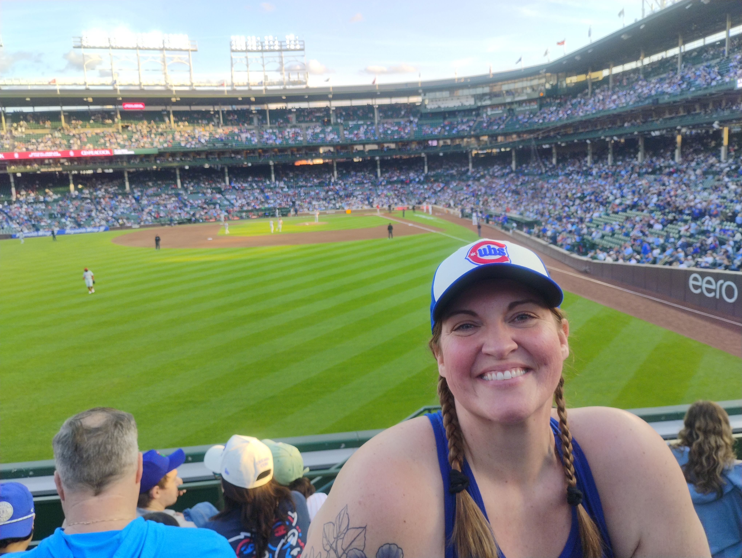
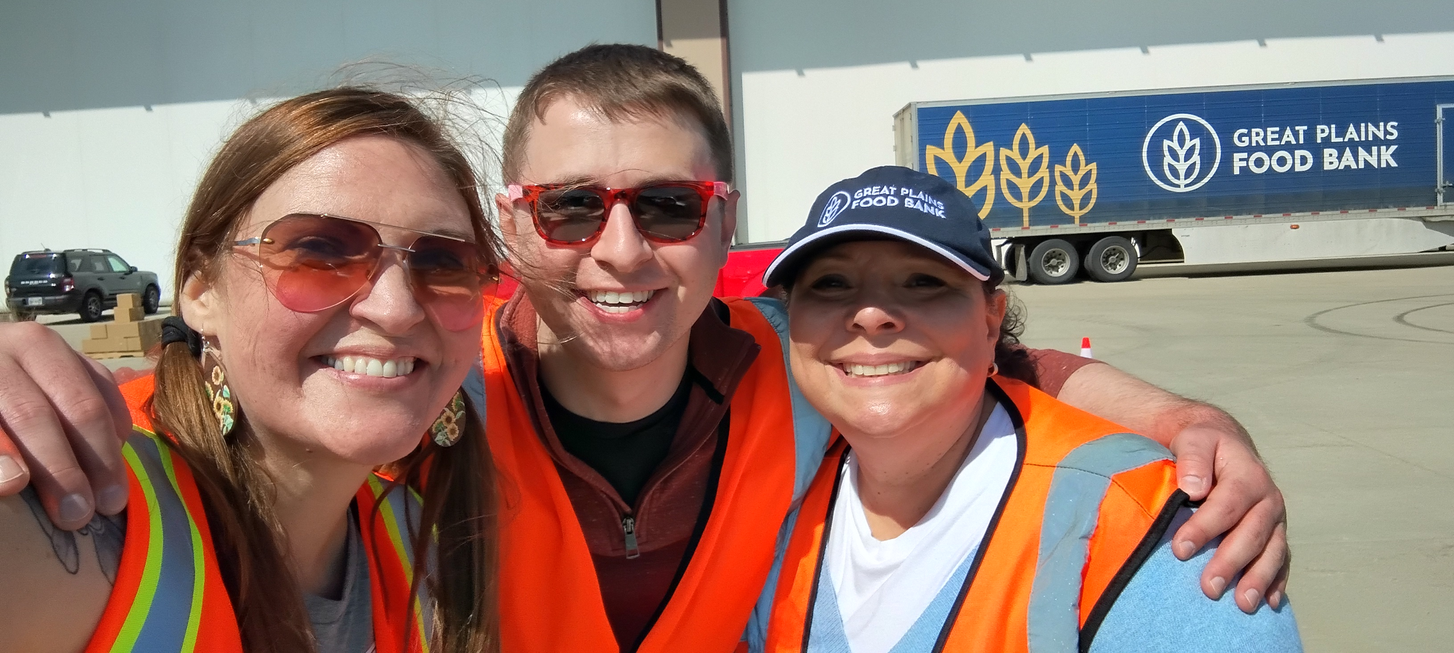
Janelle LaCoursiere – Programs and Partner Network Director
Janelle joined Great Plains Food Bank in April 2022. She oversees the development, implementation, administration and evaluation of the organization’s childhood, senior, family, and rural hunger-relief programs. She also works closely with the operations team to help ensure the delivery of services to a statewide network of partner food pantries and feeding programs. Prior to her work with Great Plains Food Bank, Janelle was the manager of women’s community programs for Sanford Health and the wellness and lifestyle medicine supervisor at Sanford Health Plan. She received her bachelor’s degree from the University of Minnesota. She is mom to Dylan (19) and Ash (16) and loves her two cats Trixie and Veronica. She enjoys the outdoors, time with friends and family, sporting events of all sorts, arts and culture events, and travel.
Contact Information:
Email: jlacoursiere@greatplainsfoodbank.org
Phone: 701-416-9126

Slide 9
Ann Prifrel - Chief Executive Officer
Ann Prifrel has served as the Great Plains Food Bank CEO since January 2026. A Midwest native with a lifelong commitment to ensuring neighbors have access to nourishing food, Ann brings more than a decade of executive leadership experience in hunger relief, nonprofit management, and large-scale fundraising.
Previously, Ann was appointed Chief Development Officer of Harry Chapin Food Bank in September 2024, where she leads strategic fundraising and marketing efforts for Southwest Florida’s largest hunger-relief organization.
Prior to joining Harry Chapin Food Bank, Ann served as Founding CEO of St. Croix Valley Food Bank. Her earlier experience includes serving as Executive Director of United Way St. Croix Valley and White Bear Area Emergency Food Shelf, as well as co-founding Shelf Saver, a software solution for food pantries and food banks. Ann holds a bachelor’s degree in sociology and a master’s degree in human resources and industrial relations from the University of Minnesota.

Slide 10
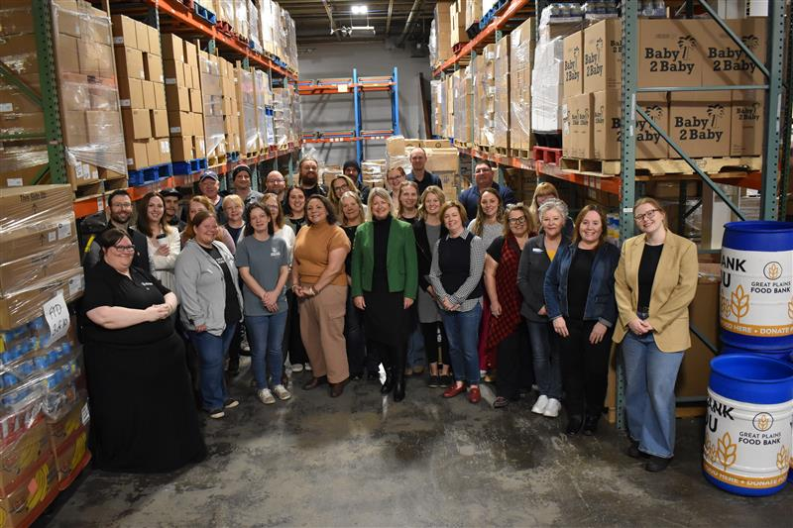
Great Plains Food Bank Full Team Picture

Slide 11
Programs & Partner Network Updates

Slide 12
Agency Support Staff
Partner Network Specialist:
Programs & Operations Compliance Manager:
Capacity Building
  Infrastructure Requests
  Best Practices
Onboarding Agencies
  Resources
  Start-up of Agency Partnership
Resources and Training
  Toolkits and print-outs
  Leah's Pantry Training coordination
  County Informational Resources
Programs/Regulatory Compliance
  Agreements
  Records
  Compliance Site Visit
  Training
    Civil Rights/Bill of Rights
    ServSafe FHFB or FPM
Food Safety Support
  Sanitation
  Pest Control
  Shelf-life
  Pantry & Meal Site Best Practices

Slide 13
Programs & Operations Compliance Manager
Supporting safe, compliant, and effective food distribution through:
  Food safety leadership and training
  Partner support and program compliance
  Agency onboarding and education
  Process improvement and documentation systems
My Goal:
Help partners and programs understand requirements, implement best practices, and build strong systems that support safe food access.

Slide 14
Key Areas of Focus
Food Safety & Program Support
Compliance & Agency Support
Coordinate AIB audits, corrective actions, recalls, and issue resolution
Provide annual food safety training and education
Support food safety standards across programs and partner agencies
Serve as a resource for questions, problem-solving, and continuous improvement
Support compliance with:
  Feeding America
  TEFAP/USDA requirements
  State & local health regulations
Maintain partner documentation, agreements, and verification records
Conduct site visits focused on coaching, education, and shared success

Slide 15
Partnership • Education • Improvement
Transitioning site visit tools to digital forms to improve efficiency and reduce paperwork
Creating clearer systems for documentation and compliance tracking
Building stronger training resources for partners and staff
Focusing on the “why” behind requirements to encourage understanding, consistency, and food safety excellence
Approach:
Compliance works best when it is collaborative, practical, and rooted in partnership—not just rules.

Slide 16

Programs & Partner Network Updates
Agency Resources:
LEAH'S Pantry Trainings
Building Nourishing Pantries, Trauma Informed Customer Service, and Trauma, Resilience, and Nourishment trainings.
Infrastructure and Capacity building for FY 2028 (July 1st, 2027- June 30th, 2028)
West ND Support Trip update from Janelle
AprilTripWest4.20.26.pptx

Slide 17
Regional Network Snapshot : Pounds Distributed from May 1st, 2025-May 1st, 2026
Cass/Clay County (Fargo/Moorhead)- 3,749,343 lbs.
Stutsman County- 281,640 lbs.
Grand Forks County- 1,116,667 lbs.
Benson/Ramsey County (Spirit/ Devil's Lake)- 284,272 lbs.
Burleigh County- 2,050,885 lbs.
Ward County- 1,196,971 lbs.
Williams County- 219,969 lbs.
Stark County- 474,560 lbs.

Slide 18
Great Plains Website Overview, Resources, Tools, & Leading Practices

Slide 19
Partner Agency Resource Center - GPFB Website
  Partner toolkits (Downloadable)
  Leading Practices
  Primarius Web Window
  Ordering Process
  TEFAP Allocations
  Surplus Inventory
  Delivery Fee Grid
  Retail Rescue and Agency Enabled Retail Rescue

Slide 20
Deep Dive – Downloadable Toolkits
Toolkits Available for Partners
  Client Choice
  Food Safety
  Food Drive
  Succession Planning
  Recipe Collection

Slide 21
Leading Practices
Agency Partner Testimonials
  Highlighting capacity building efforts
  Food distribution leadership recognition
  Community impact stories
What is a leading practice you have implemented at your site and what have you seen as a result?

Slide 22
Primarius Web Window (PWW)
•Partner Experience
•Software Issues
•Ordering Process
•Inventory Management
•Delivery Schedule

Slide 23
Ordering Process
•All partner ordering windows open on Fridays at 8am CST and close on Mondays at 11:59pm CST.
•Partners can place 1 order during their designated ordering window each month. TEFAP eligible agencies receive their allocation as a second order.
•If partner places a choice order, it is combined with their TEFAP allocation, the warehouse team has 1 pick ticket per agency to pull orders more accurately.

Slide 24
Ordering: Inventory Management
•PWW has live inventory so partners can see updates in real time.
•PWW will timestamp an order once the SHOP tab is clicked.
•A Data Entry order is created-See Order History
•Product availability changes and is not guaranteed until orders are successfully submitted.

Slide 25
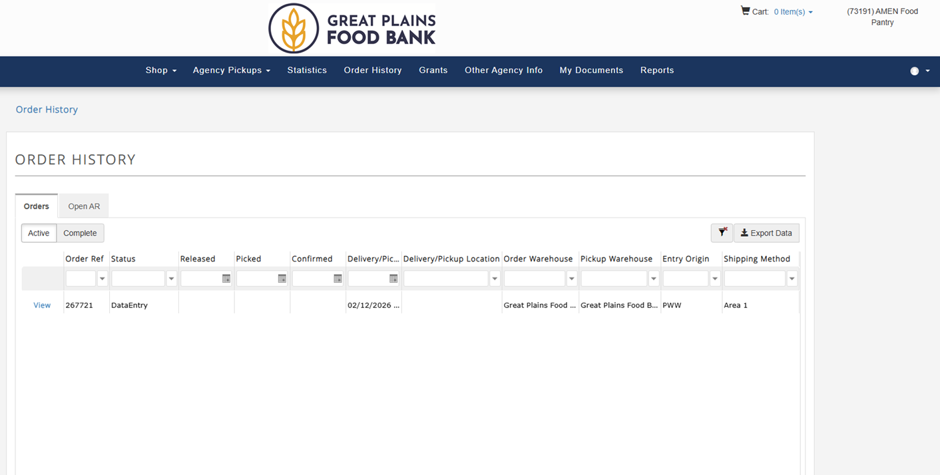
PWW Ordering: Screenshare by Hope
https://greatplainsfoodbank.primarius.app/pww/Home/Login/?ReturnUrl=%2fpww%2fDocument%2fIndex

Slide 26
TEFAP Allocation
TEFAP allocation procedures will be updated at the end of Fiscal Year 2026, with a new process taking effect on July 1, 2026.
During this transition period, we ask that partner agencies support the anticipated increase in product volume by expanding open hours where possible and making TEFAP-distributed items more consistently available.
Agencies experiencing capacity or storage constraints may request a temporary three-month pause in TEFAP allocation.

Slide 27
What to do with Surplus Inventory?
Share with other agencies ( If TEFAP approved site ensure TEFAP items are going to another TEFAP approved site).
Give out more of the TEFAP items and/or do not put limits on these items.
If a neighbor needs urgent food assistance but has reached the limit of pantry boxes available at your site, please prepare a TEFAP-only resource box to serve as a temporary “gap” resource until the following month.

Slide 28
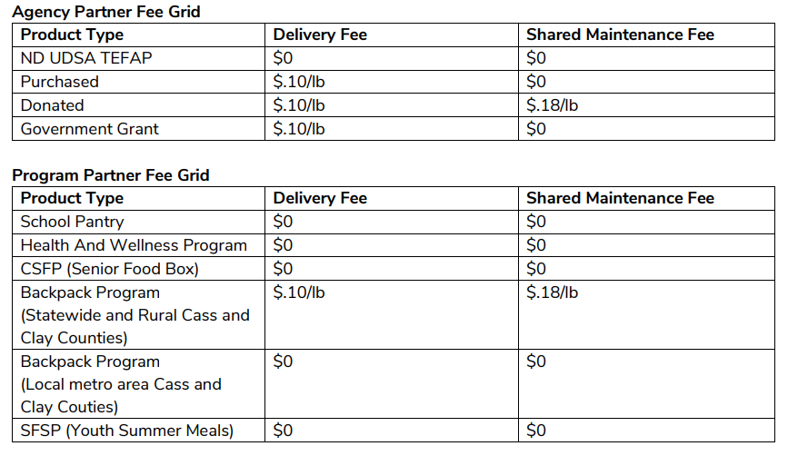
Delivery Fee Grid
Can be found in Agency Partner Handbook

Slide 29
How do we Source the Products for the TEFAP Allocation?
The Emergency Food Assistance Program (TEFAP) was established to support agricultural producers while providing food assistance to communities in need. The program helps stabilize markets by purchasing products from farmers who may face challenges selling or distributing their goods.
TEFAP is a broad and flexible program, with available products varying based on current market and agricultural conditions.
Great Plains Food Bank receives four TEFAP orders annually, each consisting of a defined list of available foods within a set budget.
Additional “bonus” product offerings may be provided periodically, depending on current agricultural surpluses and needs.

Slide 30
Retail Rescue
Retail Rescue Program
The Retail Rescue Program is currently available in the Fargo, Moorhead, and Bismarck areas, based on the locations of distribution centers and driver capacity.
Through this program, partner agencies receive end-of-day donations from a range of contributors, including both large and small retailers such as grocery stores and convenience outlets.
The program offers mutual benefits: agencies gain access to additional food resources, while participating donors may be eligible for applicable tax deductions.

Slide 31
Agency Enabled Retail Rescue
Participation in this program is highly dependent on the availability of donors within a given area, as well as their willingness to participate.
Similar to the Retail Rescue Program, partner agencies are responsible for arranging their own transportation to pick up donations directly from donor locations and deliver them to their facilities, as driver support is not provided.
Great Plains Food Bank can assist participating agencies by providing resources to support safe food transportation, including thermal blankets, ice packs, and coolers.

Slide 32
Questions for Hope and Stephanie?

Slide 33
Bill of Rights
Documents must be clearly posted and readily visible at all agencies partnered with Great Plains Food Bank. These materials are intended to communicate and uphold the rights of both partner agencies and individuals receiving services, ensuring transparency, accountability, and fair access to food assistance. Both documents are available on the Partner Agency Resource Center.
Agency Partner Bill of Rights – This document outlines the rights and responsibilities of partner agencies operating as food distribution sites in collaboration with Great Plains Food Bank. It serves to clarify expectations, promote consistent standards, and support agencies in delivering services effectively and with integrity.
Neighbor Bill of Rights – This document details the rights of individuals receiving food assistance (“neighbors”), including expectations for respectful treatment, fair access to services, and protection of dignity and confidentiality throughout the service experience.

Slide 34
Food Movement Survey- Please Complete
Food Movement Survey – Fill out form

Slide 35
Break
Lora to lead Coconut Stretch Exercise

Slide 36
Feedback and Discussions

Slide 37
Service Insights on Meal Connect or Neighbor Intake
What is it? Moving from paper intake to digital.
Fact driven database- Ability to access historical data, etc. With use of SIMC.
How partners benefit- no longer having to enter statistics when using SIMC.
Rollout timeline- Requirement through partnership with GPFB by the end of June 2027.

Slide 38
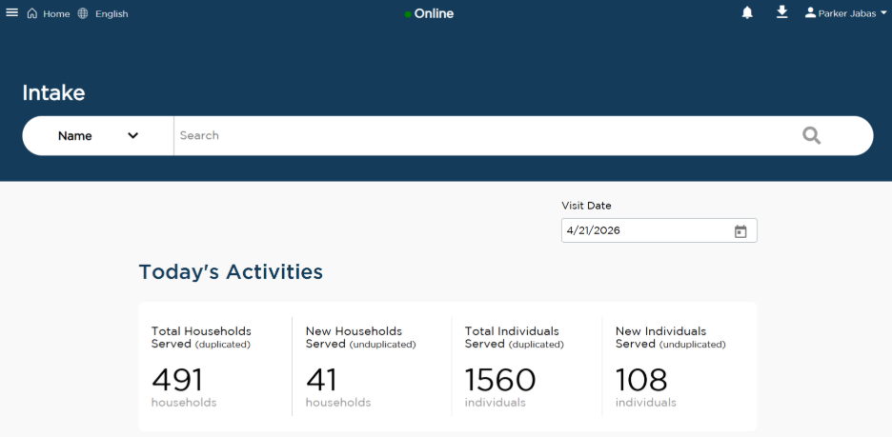
Service Insights on MealConnect (often referred to its acronym SIMC for conciseness, Neighbor Intake, Electronic Intake, etc.) is a website created by Feeding America to be used by food banks and food pantries while collecting required information from the neighbors we serve. There are several advantages to using SIMC over traditional paper intake including but not limited to:
Collect each neighbor’s information once, and then reuse/update it
Not having to decipher cryptic handwriting
Collected data is instantly accessible to Great Plains Food Bank
Set up reservations for future neighbor visits
Can view your food pantry’s historical data

Slide 39
Frequently Asked Questions (FAQs)
If I collect statistics using SIMC, do I still need to enter numbers into PWW?
  Nope! As long as you do intake on SIMC, we instantly have access to the numbers we need. However, if you prefer to record pounds in PWW, that is okay as long as intake is still done in SIMC without the pounds entered.
Do I need to install any special software to use SIMC?
  Nope! SIMC is a website that can be accessed from any device with an internet connection. Feel free to use a computer, laptop, tablet, or even your smartphone! We recommend that you use your smartphone for doing SIMC intake at mobile distributions as it is easy to carry around and typically has access to mobile data.
Are there any resources offered once onboarded to SIMC?
  Yes! As part of onboarding, we will provide you with a Chromebook along with some basic accessories if you do not already have a preferred device. While we technically own these, you can use them as long as you continue to use SIMC and remain in good standing as a food pantry.

Slide 40
Does it cost anything to use SIMC?
  Nope! SIMC is free to use for Feeding America partnered with food banks and their food pantries. Since Great Plains Food Bank is partnered with Feeding America, all our partner food pantries can use SIMC.
Do I need an internet connection to use SIMC?
  Yes. However, if you do not have access to the internet at your food distribution site, we will reimburse you for the cost of our recommended mobile hotspot and plan currently listed on our website. Pricing changes, so please refer to our website for what we will currently reimburse. Since this process is time consuming and costs money for us, we ask that you confirm that you cannot use your own internet or mobile hotspot first before requesting reimbursement.

Slide 41
Questions?
To Learn More About SIMC:
Please reach out to Parker Jabas, our Data Insights Manager, using one of the following contact methods:
Email: pjabas@greatplainsfoodbank.org
Phone: (701) 997-7284

Slide 42
Agency Partner Feedback- Survey and Suggested Topics
Inventory Challenges/diversify food sources
Cultural food access/or special dietary needs GF/low sugar/ low sodium
Volunteer recruitment
Choice model implementation
Produce distribution strategies (Pop-Up Distributions)
Fundraising and grant writing-sustainability

Slide 43
Agency of The Year Presentation

Slide 44
2025 Agency Of The Year
Agency of the year is:
Highlight partners who exemplify the Great Plains Food Bank values:
Service Award: Belfield Medora Food Pantry
Passion Award: West Fargo Eats
Innovation Award: McKenzie County Food Pantry

Slide 45
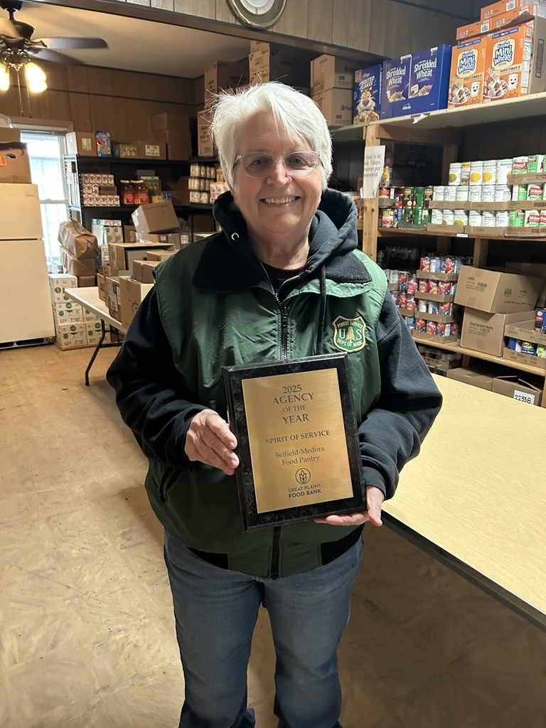
Service Award: Belfield Medora Food Pantry
Belfield Medora Food Pantry-
Belfield Medora Food Pantry supports the community of Stark and surrounding counties. This October marks 40 years since the start of the Belfield Medora Food Pantry according to Belfield Lutheran Church council minutes. In 2025 he food pantry gave out 51,736 pounds of food, an average of 4,311 pounds of food per month. With economic difficulties, people who fall on unexpected challenging times can always look to the BMFP for basic needs. They have helped many families get through tough times, who sometimes return to volunteer or donate once back on their feet. After asking several people in the community about the Food Pantry, every person knew someone who has received help from their resources.

Slide 46
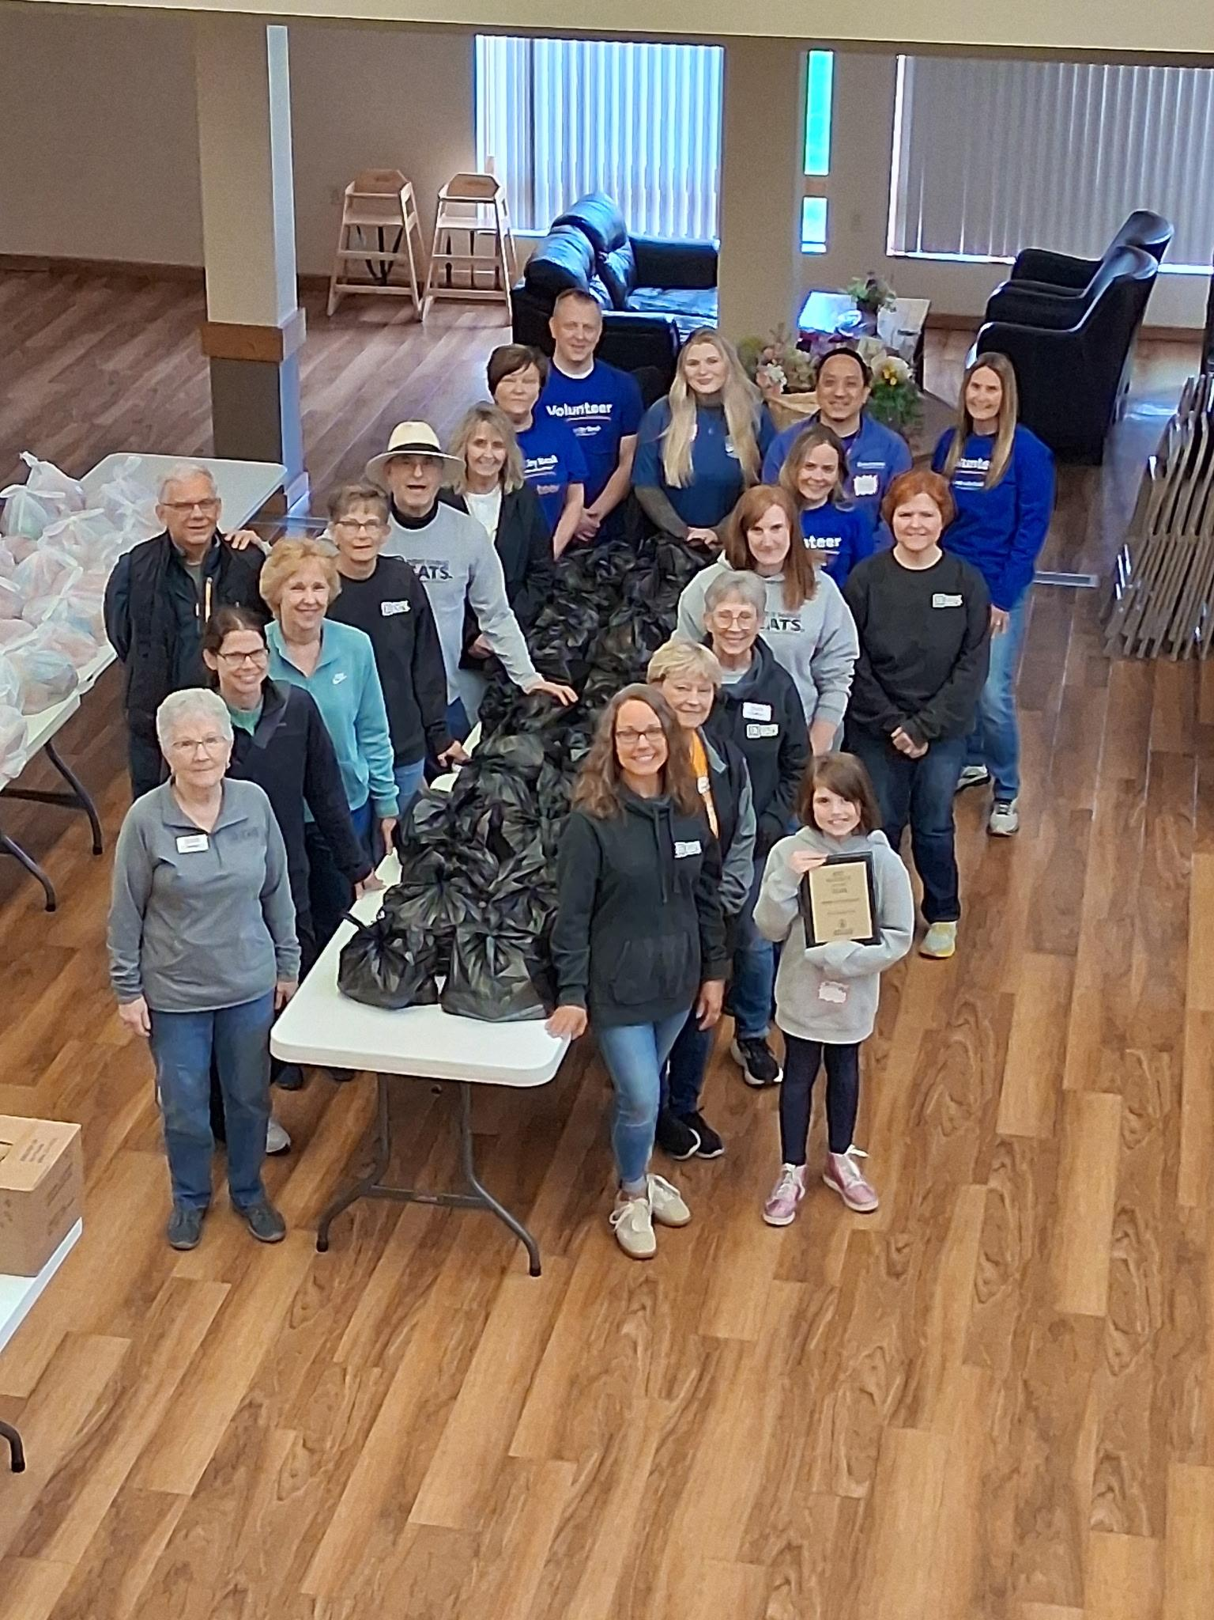
Passion Award: West Fargo Eats
West Fargo Eats-
West Fargo Eats has significantly expanded the organization’s hunger relief efforts over the past year. In addition to maintaining a consistent food pantry along with existing food rescue partnerships, West Fargo Eats has taken on multiple new agency-enabled pickups, including locations such as Caribou Coffee and Kwik Trip. These same-day recovery programs help ensure that fresh food quickly reaches partner agencies and families in need. West Fargo Eats is also an active participant in the Pop-Up Distribution Program and consistently steps up to accept additional product when available, ensuring that surplus food is efficiently distributed throughout the community. Through these expanded partnerships and flexible distribution efforts, West Fargo Eats continues to broaden its reach and strengthen food access for neighbors experiencing food insecurity.

Slide 47
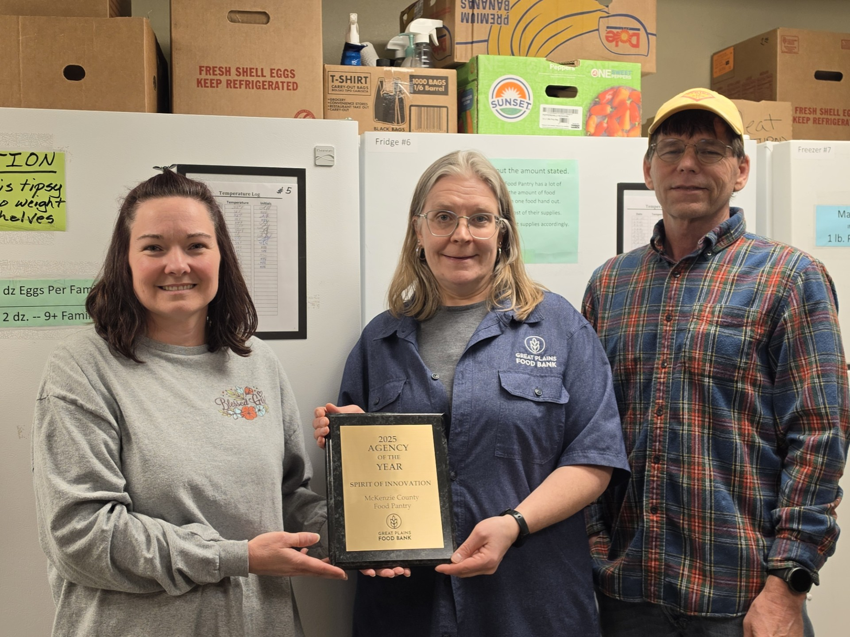
Innovation Award: McKenzie County Food Pantry
McKenzie County Food Pantry-
The McKenzie County Food Pantry plays a vital and far-reaching role in hunger relief across our region. Serving eight communities throughout McKenzie County, the pantry provides consistent and reliable food assistance to individuals and families facing food insecurity. Regular food distributions are held twice per month, ensuring households have ongoing access to nutritious food. In addition, emergency food boxes are available as needed, allowing the pantry to respond quickly and compassionately to urgent situations. Beyond general food distribution, the pantry has developed targeted programs to meet the unique needs of vulnerable
populations. A dedicated senior program operates monthly, providing supplemental food support to older adults who often face fixed
incomes and increased financial strain. This program helps ensure seniors can maintain both their independence and their health. The pantry also partners with local schools to operate a BackPack Program, which supplies children with food to take home over weekends and school breaks. By addressing weekend hunger, the program supports students’ well-being, academic focus, and overall stability. Through its broad geographic reach, responsive emergency services, and specialized programs for seniors and children, the McKenzie County Food Pantry demonstrates a comprehensive and community-centered approach to hunger relief. The organization remains
steadfast in its mission to ensure that no one in McKenzie County goes without access to healthy, nutritious food.
Featuring: Lora Stone

Slide 48
Thank you for your attendance!

