Slide 1
PARTNERSHIP
ONBOARDING

Slide 2
INCLUDED MATERIALS
Required:
Partner Handbook​
Order & Delivery Schedule​
NDSU Shelf-Life Guide​
Certificate of Partnership​
Log Templates (Temp., Pest, etc.)​
Example Grievance Policy​
How to Run a Food Pantry Guide​
PWW Login & Navigation Guide​
Retail Rescue Agreement
If Applicable:​
TEFAP Policy Manual ​
Justice For All Poster ​
Written Notice of Beneficiary Rights ​
TEFAP Income Guidelines​
Non-Discrimination Statement

Slide 3
FOOD BANK
FOOD PANTRY
A food bank is a large distribution center that collects, stores, and distributes food to community partners such as food pantries, soup kitchens, and shelters. Food banks typically do not serve clients directly. Instead, they supply food in bulk to organizations that provide direct services to individuals
and families.
A food pantry, on the other hand, is a community-facing site that distributes food directly to people in need. Pantries receive food from food banks and other sources, and they are the places where individuals and families go to pick up groceries or meals.

Slide 4

Feeding America is the largest charity working to end hunger in the United States. The GPFB is a proud partner food bank of Feeding America along with 199 other food banks across the US and Puerto Rico. ​
​
Learn more at feedingamerica.org.

Slide 5
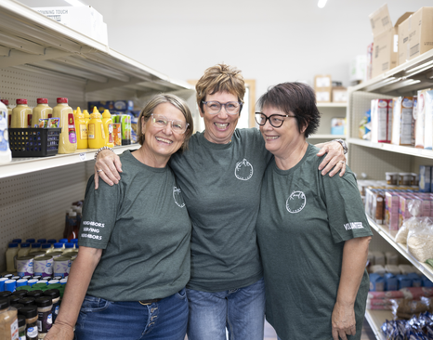
FOOD PANTRY/SHELF​
A food pantry (also known as a food shelf) is a community-based organization that distributes groceries directly to individuals and families in need. Clients typically receive food items such as shelf-stable products, fresh produce, dairy, and protein to prepare meals at home. Food pantries may operate on scheduled distribution days or by appointment and often serve households within a geographic area.

Slide 6

MEAL SITE
A meal site, sometimes referred to as a soup kitchen, is a program that prepares and serves ready-to-eat meals to individuals in a communal setting. Meals are provided on-site at designated times and are typically open to the public, with no requirement for food preparation at home. Meal sites help address immediate hunger needs and often provide a welcoming space for community members experiencing food insecurity.

Slide 7
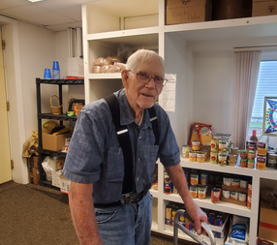
SENIOR COMMODITIES PROGRAM​
The Senior Commodities program provides monthly boxes of nutritious, shelf-stable food to low-income seniors to help supplement their diets and support their overall health. The boxes typically include a variety of staple items and are distributed through local agencies or community partners.

Slide 8
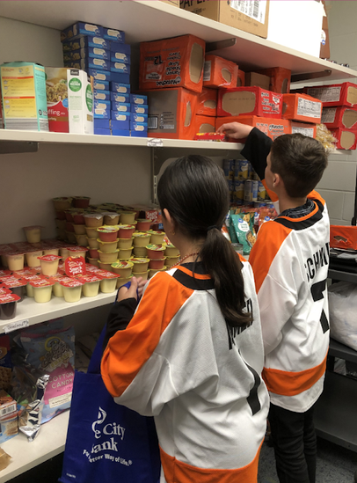
SCHOOL PANTRY PROGRAM ​
The School Pantry Program offers food pantry directly inside of a school; it allows student access to food assistance. A school pantry can take many forms and sizes depending on the need of the school and the space available. School pantries contain many of the items you will find inside a traditional Great Plains Food Bank partner food pantry. Items may include canned goods, cereals, pasta, personal items, clothing, fresh and frozen products. Each school may customize the program to match their available resources and the community’s needs.

Slide 9
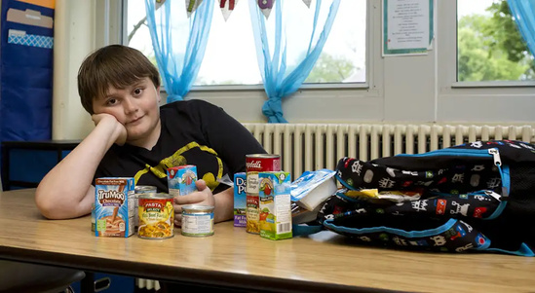
BACKPACK PROGRAM​
The Backpack Program provides children with a bag of nutritious, easy-to-prepare food to take home over weekends or school breaks when they may not have access to regular meals. The food is discreetly distributed through schools or youth organizations to ensure students have consistent nourishment outside of school hours.

Slide 10
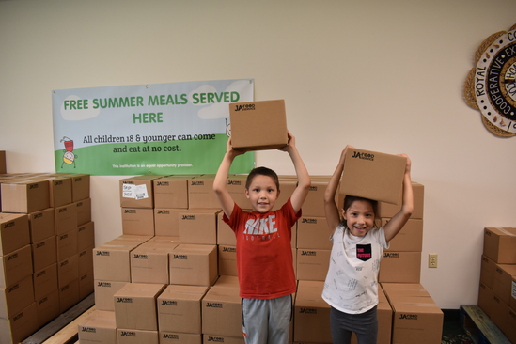
YOUTH SUMMER MEALS​
A program that provides free, nutritious meals to children and teens during the summer months when school is out and regular school meal programs are unavailable. Meals are served at community sites such as schools, parks, and libraries to help ensure youth have consistent access to healthy food all summer long.

Slide 11
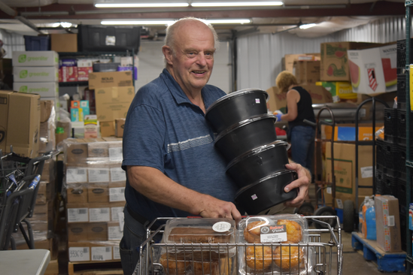
RETAIL RESCUE AND AGENCY ENABLED RETAIL RESCUE​
A program that collects safe, high-quality surplus food from grocery stores and other retailers—such as produce, dairy, bakery items, and meat—and redistributes it to food pantries and community partners instead of letting it go to waste. This helps reduce food waste while increasing the amount of fresh food available to individuals and families in need.

Slide 12
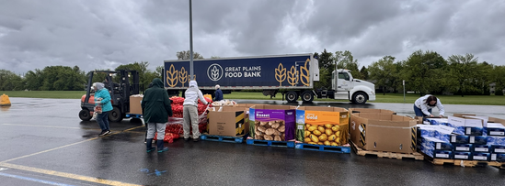
POP-UP PANTRY​
A temporary, mobile food distribution that brings fresh produce, pantry staples, and other groceries directly to communities with limited access to food assistance. These events are scheduled as needed and allow families to receive food at convenient locations outside traditional pantry hours or sites.

Slide 13
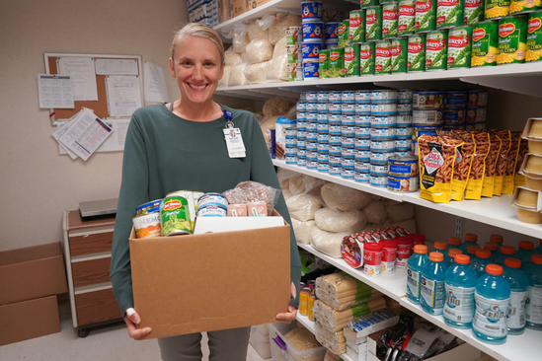
HEALTH AND WELLNESS PANTRY​
Housed inside a clinic, the Wellness Pantry program offers patients screening positively for food insecurity immediate food assistance. Patients can expect to return home with 20-30 pounds of food, resources for other local services, and a connection to GPFB SNAP outreach team.

Slide 14

SWAP PROGRAM​
Supporting Wellness at Pantries (SWAP) is designed to help promote healthy food choices at a food pantry. Using a stoplight nutrition ranking system, foods are ranked Green, Yellow, or Red based on the levels of Saturated Fat, Sodium, and Added Sugars. By using SWAP, food pantry guests can see how foods are ranked and to make healthy choices that support a balanced diet. SWAP is best used in client choice pantries where guests are empowered to choose their food with dignity.
PDF LINK

Slide 15
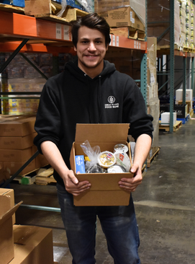
CLINIC FOOD BOX PROGRAM​
Located in clinics, Clinic Food Boxes are pre-packaged boxes supplying patients who screen positive for food insecurity with approximately 15 pounds of shelf stable foods.

Slide 16
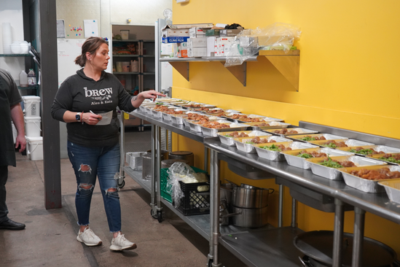
KITCHEN COALITION ​
A program that partners with local restaurants, caterers, and community kitchens to prepare fresh, ready-to-eat meals for individuals and families facing food insecurity. By utilizing existing kitchen capacity, the program provides high-quality meals while supporting local food businesses and reducing food waste.

Slide 17
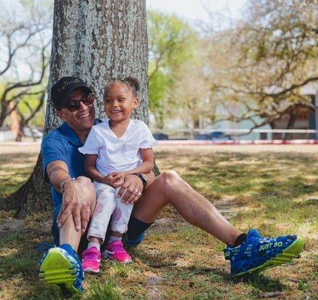
SNAP PROGRAM
The Supplemental Nutrition Assistance Program (SNAP) is a federally funded nutrition assistance program that helps eligible low-income individuals and families purchase food. Benefits are provided monthly through an Electronic Benefit Transfer (EBT) card, which can be used to buy approved food items at authorized retailers, including grocery stores and some farmers markets. SNAP is designed to reduce food insecurity, support household food budgets, and improve access to nutritious foods.

Slide 18
REPACK PROGRAM​
The Meal Repack Programs allows schools to support the nutritional needs
of students outside of school by repackaging, freezing, and distributing
leftover food from meal services. Each repack program looks a little different, and the program can be customized to meet the needs of each unique school/district. This low barrier approach can positively impact students access to healthy food while reducing food waste produced by on-site kitchens.

Slide 19

HUNGER COALITIONS
Jill Ambuehl
Coalition Coordinator
Jambuehl@greatplainsfoodbank.org
701-476-9122
VISION
The Cass Clay Hunger Coalition (CCHC) sees a healthy community built on collaborative solutions that support equitable access to food while addressing the root causes of hunger.
WHAT IT MEANS TO BE A MEMBER
CCHC members attend monthly meetings, participate in coalition-led events & activities, share information & resources within their organizations, and support the overall strategic vision of the coalition.
MEMBER BENEFITS
CURRENT STRATEGIES
Expand and Strengthen Coalition Membership
Exploring Pantry Delivery Options
Hunger Simulations
Space to Promote Resources, Opportunities & Programs
Discounted Coalition Sponsored Training & Event Fees
Voting Privileges to Inform Coalition Priorities
The CCHC meets the first Tuesday of each month from 8:15 – 9:30am at Fargo Cass Public Health

Slide 20

HUNGER COALITIONS
Jill Ambuehl
Coalition Coordinator
Jambuehl@greatplainsfoodbank.org
701-476-9122
VISION
A collaborative partnership working to expand food access, promote nutrition, and strengthen local solutions to end hunger in North Dakota.
WHAT IT MEANS TO BE A MEMBER
CHFND members subscribe to emails, attend monthly meetings, participate in coalition-led events & activities, share information & resources within their organizations, and support the overall strategic vision of the coalition.
MEMBER BENEFITS
CURRENT STRATEGIES
Expand and Strengthen Coalition Membership
Expand School Meal Repack Program
Inform and Educate
Space to Promote Resources, Opportunities & Programs
Discounted Coalition Sponsored Training & Event Fees
Voting Privileges to Inform Coalition Priorities
CHFND meets virtually the fourth Tuesday of each month from 1:00 – 2:15pm

Slide 21
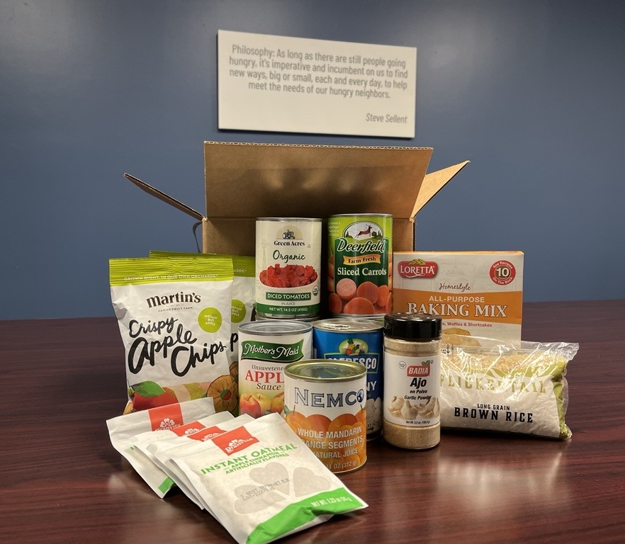
TRIBAL ELDER NOURISHMENT PROGRAM​
The Tribal Elder Nourishment Program helps to improve nutrition security and food access of Tribal members, with the focus of elders aged 50 years and older. This program provides, to the registered participant, a monthly box of shelf-stable food. Other possible items provided include frozen protein, recipe book, and emergency kit.

Slide 22
SOURCES OF PRODUCTS​
Donated:​
Food contributed by growers, manufacturers, retailers, and individual donors or groups.​
Programs (TEFAP):​
Federally provided food that is supplied to pantries at no cost.​
Purchased:​
Food bought by the food bank and offered to pantries at a lower cost than retail. (Service and delivery fees apply.)

Slide 23
PARTNER AGENCY RESOURCE CENTER
(PARC)​
https://greatplainsfoodbank.org/about-us/our-partners/partner-agency-resource-center/​
​
Where to find announcements​
How to navigate the PARC​
Documents provided and where to find them​
PWW Login in shortcut

Slide 24
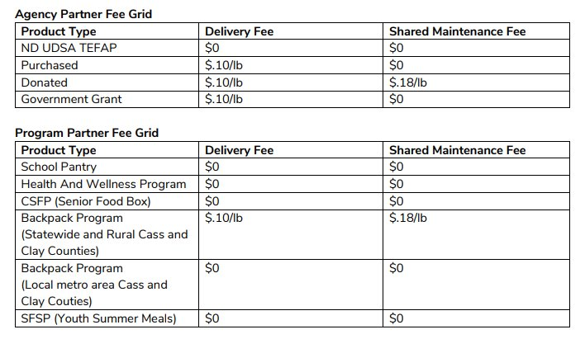
PWW OVERVIEW
How to Order​
Order History​
Statistics
Link to PWW

Slide 25
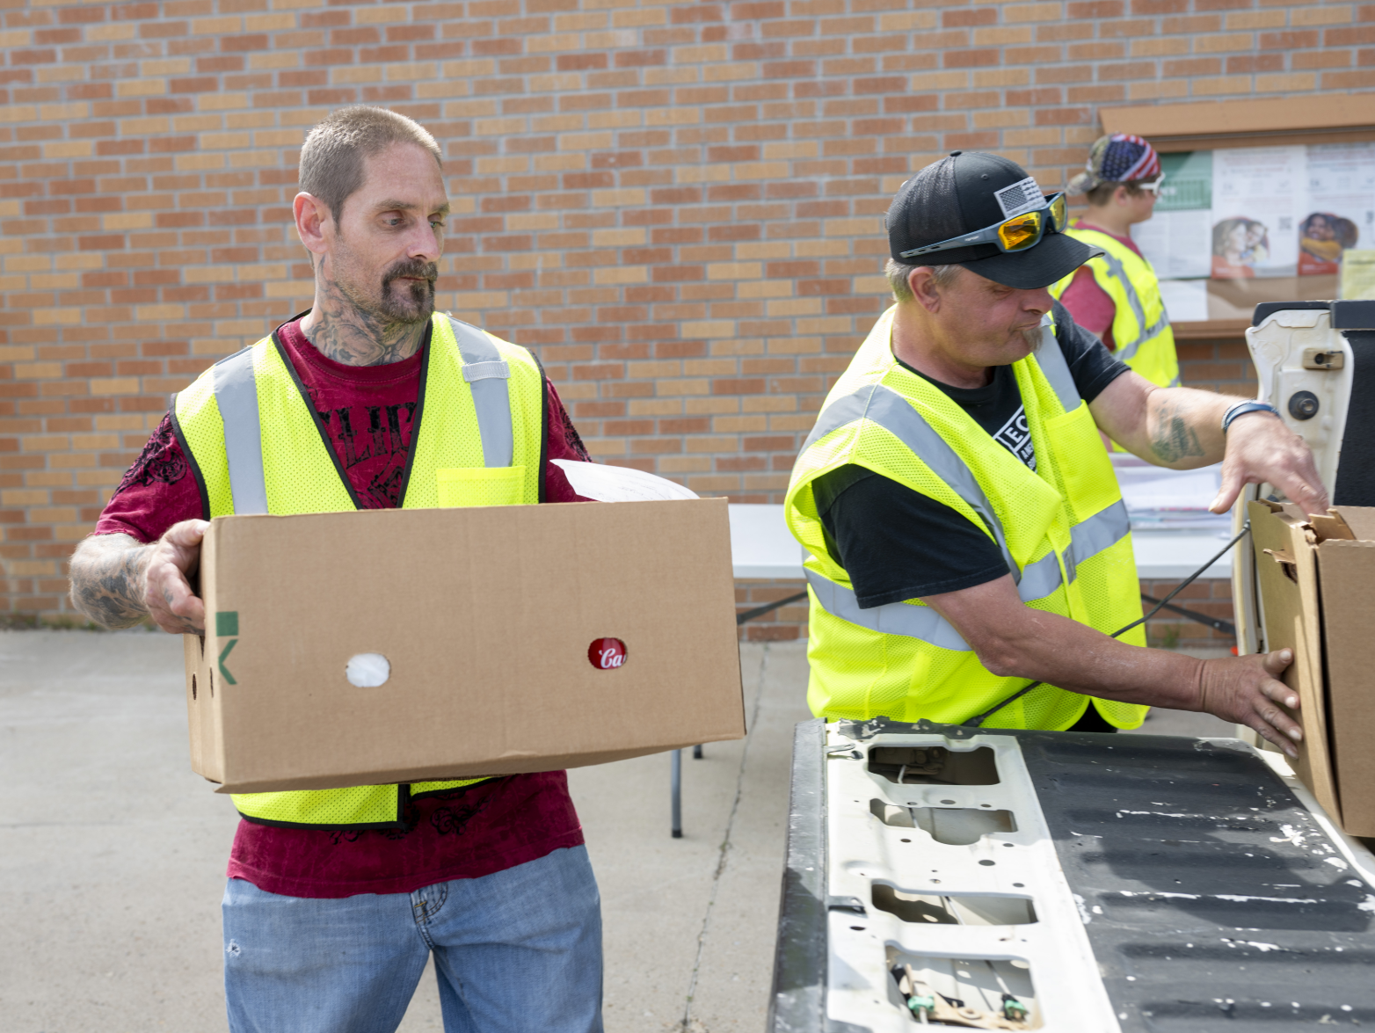
SERVING THE PUBLIC
Equity, Diversity, and Inclusion​
Client Eligibility/ Intake​
Residency​
Discrimination ​
External and Internal Bias’s​
Religious Proselytizing (Next Slide)
Neighbor Rights
Partner Agency Rights

Slide 26
RELIGIOUS PROSELYTIZING​
We recognize that many agency partners are located in and/or sponsored by a church or religious organization; however, agency partners cannot participate in religious proselytizing. This includes discriminating against neighbors based on faith or beliefs, requiring, or requesting neighbors attend a service or other faith-based activity, or asking questions pertaining to religious affiliations verbally or on an intake form.
ALLOWABLE ​ | ​ | UNALLOWABLE ​
Religious artifacts and paintings hung on the walls that are regular fixtures in the room. ​ | ​ | Requiring neighbors to take religious items/materials and/or inserting them in the bags/boxes when distributing food. ​
Provide pamphlets for faith-based activities as part of a larger display of resources. ​ | ​ | Inserting faith-based pamphlets into bags/boxes when distributing food. ​
Having a pastor or religious official help with the food distribution. ​ | ​ | Require or encourage neighbors to have a religious conversation with a pastor or religious official. ​
Praying with volunteers or neighbors before or after food distribution; only if it’s optional and done in a space and time separate from the food distribution. ​ | ​ | Praying with volunteers or neighbors at the same time and in the same room as the food distribution. ​

Slide 27
INTENDED USE OF RESOURCES FROM GPFB​
Free to Those in Need:
All food must be provided to individuals and families in need at no cost and without any requirements.
Volunteer Use:
Volunteers are not allowed to use food intended for distribution. If they wish to participate as recipients, they must follow the same process as the public.
Thank-You Gifts, Fundraising, or Prizes:
Food products may not be used for thank-you gifts, fundraising events, or as prizes.
Tasting and Testing:
Coordinators and volunteers may take small amounts of food for sample tastings to aid in product education and movement. All safe food storage and preparation guidelines must be followed.

Slide 28
Good Samaritan Food Donation Act- A federal law that encourages the donation of food and grocery products to nonprofit organizations by protecting donors from civil and criminal liability if the donated food is safe at the time of donation. The law applies if the donation is made in good faith and without gross negligence. Its goal is to reduce food waste and increase the availability of food for people in need.​
ServSafe Food Handler Certificate for Food Banking Training- Due to be completed on a biannual basis.​
Temperature Log- To be recorded monthly: recommended to be checked weekly. ​
Pest Control Log- To be recorded monthly and if commercially checked, ensure to file all invoices with notes. ​
Food Storage Guidelines
FOOD​
SAFETY
Food Safety Booklet
Food Safety Toolkit

Slide 29
THE
EMERGENCY
FOOD
ASSISTANCE PROGRAM
(TEFAP)
Where to find monthly TEFAP Allocation on PWW: Order History ​
Civil Rights Training- Required to be completed annually. ​
USDA Non-Discrimination Statement ​
On-Site Postings:​
  TEFAP Income Guidelines​
  Justice for All Poster

Slide 30
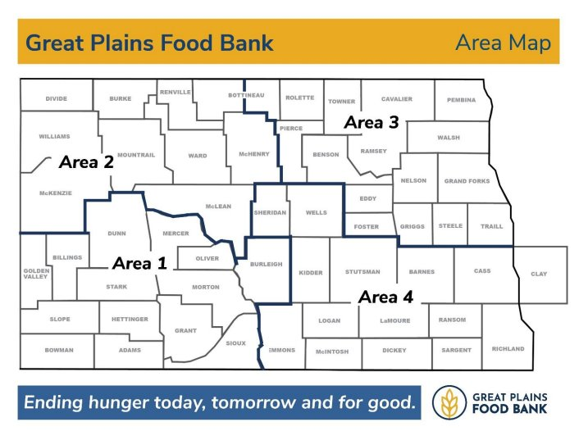
ORDER
& DELIVERY​
Order and Delivery Calendar​
  Area Sections Overview​
  No Delivery Week Once a Month​
  All timeframes start on Friday at 8 AM CST and continue through Monday at 11:59 PMCST. Adjustments to the time frames may be made incase of holidays, onsite inventory, weather closures and staff schedules.

Slide 31
BILLING
PWW- How to view invoices (My Documents)​
Payments:​
  Only checks accepted​
  Include your agency reference number on memo section.​
  Required to be paid monthly.

Slide 32
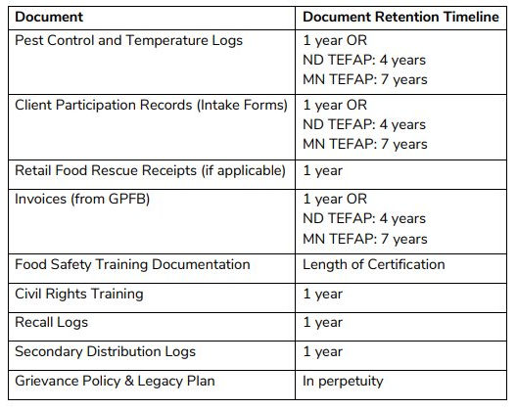
PAPERWORK REQUIREMENTS​
Agreement/Partnership Agreement – annual resign​
Membership fee of $50 applied annually​
Biannual Site Visit-​
  Affiliation letter (if applicable)​
  Church Verification (if applicable)​
Documentation Retention:

Slide 33
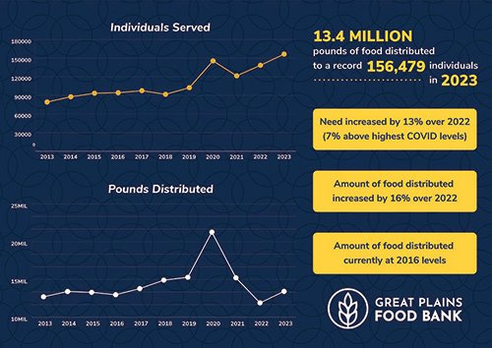
REPORTING AND TRACKING-NEIGHBOR INTAKE (SIMC)​
Statistics Required:​
  Seniors (60+yrs)​
  Adults (18-59yrs)​
  Children (0-17yrs)​
  Household Count​
  Pounds Distributed​
Parker to train on Neighbor Intake
(SIMC)

Slide 34
SUSPENSION​
Agencies to be suspended when:
Invoices unpaid 60 days
Statistics unentered 45 days
Agreements not received by Food Bank
Food Safety Concerns
Civil Rights Concerns
Unverified/Invalid 501c3

Slide 35
NEXT STEPS
Your Specialist will send a follow-up email after orientation to schedule a Teams meeting within the next three months to review progress and identify any areas where support may be needed.​
Set a reminder for your first order timeframe.​
Complete Food Handler Training, if not already completed.​
Complete TEFAP requirements, if applicable.
Start creating a succession plan & grievance policy if not already completed.

Slide 36
CSFP & SNAP
Heather Foss | hfoss@greatplainsfoodbank.org | 701.997.7285
School/College Pantries, BackPack, Youth Summer Meals
Alicia Triemert | atriemert@greatplainsfoodbank.org | 701.476.9114
Retail Rescue & Agency Enabled Retail Rescue
Stephanie Erickson | serickson@greatplainsfoodbank.org | 763.913.6433
Repack Program
Jill Ambuehl | jambuehl@greatplainsfoodbank.org | 701.476.9122
Tribal Elder Nourishment Boxes
Mel Ell | mell@greatplainsfoodbank.org | 701.476.9121
Clinic Food Boxes & Kitchen Coalition
Ashley Baker | abaker@greatplainsfoodbank.org | 701.248.5952
East Side – Pantries & Meal Sites + Pop-Up Pantries
Alissa Finke | afinke@greatplainsfoodbank.org | 701.405.3098
West Side – Pantries & Meal Sites
Kayla Beck | kbeck@greatplainsfoodbank.org | 701.390.2513
Program Contacts

Slide 37
THANK YOU!​
Any Questions or Concerns?​

