Slide 1
Welcome!

Slide 3
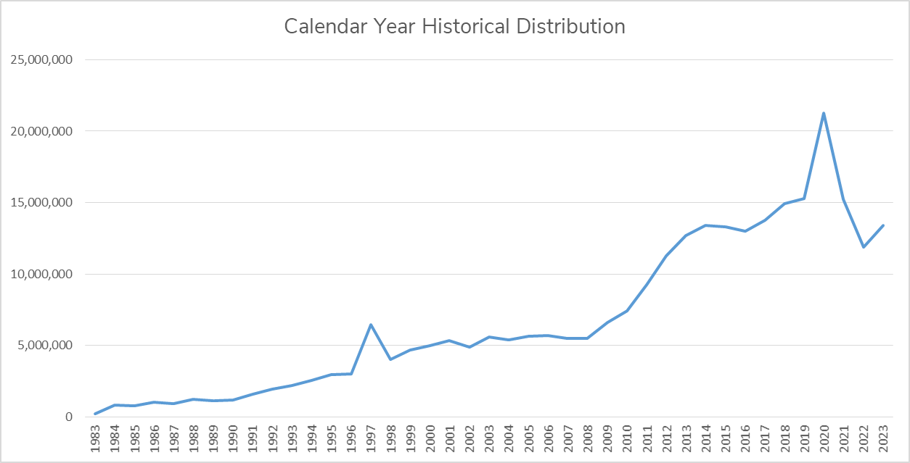

Slide 5
What We’re Going To Do
Continue to Excel at Recovering Food and Distributing it
Embracing Technology that Helps us Work Smarter Not Harder
Investing in Updating Fleet/Equipment to Prioritize Safety
Collaborating / Connecting / Partnering
Find and Fill Unique Gaps (Programs, Transportation, Workforce Development, Social Enterprise Opps,)
Advancing Equity within Tribal Communities
Finding New Funding Sources (Gov funding)
Leverage Relationships/Strengths
Notes:
Add a quick glimpse of where we are going. Big broad ghighlights. Not in the next year necessarily, but in general the direction we are headed.
READ:
Collaborate – we can’t do everything. Shouldn’t.
New Funding – Gov
Leverage relationships. strengths of team, board, cabinet in order to level up
And finally…click

Slide 6
What We’re Going To Do
FOOD:
NEIGHBORS:
Find more donated food
Retail rescue
Increased food purchasing
$3M/year
State funding to purchase local foods
Cultural/medical foods
Advocacy – federal nutrition programs
PA infrastructure
Equipment (coolers, freezers)
Longer term needs
Link to other services/programs
SNAP
Advocacy – federal nutrition programs
Cultural/medical food needs
Tracking mechanisms – holistic
Identify barriers – reduce
Personalized solutions – community based

Slide 7
Challenges:
More expensive to purchase/move food
Aging building/fleet
More competition for dollars
Inflation/Economy
Softening fundraising
AI impact on food manufacturing
Election year
Impacts media, fundraising, post election action
Advocacy – federal nutrition programs
Workforce issues (underemployed, positions)
Farm Bill
TEFAP, CSFP, WIC, SNAP, FDPIR

Slide 10
We Are
52 Staff Strong
2 Locations
205 Agencies
156,479 People
11.1M Meals
450 Staff Strong
198 Food Banks
60,000 Meal Programs
44M People
5.3B Meals

Slide 11
We Are
Ending Hunger
Together!

