Slide 1
Creating a Sense
of Belonging

Slide 2
Importance of
creating a sense of belonging
Belonging is about being “seen” and “respected,” and stands in contrast to “othering,” a process that denies people recognition of their full humanity.
Close your eyes and imagine…

Slide 4
Diversity in North Dakota
White
86.6%
American Indian/ Alaska Native
5.3%
4.6% are foreign born
6.7% speak a language other than English at home
Hispanic
4.6%
7.7% are living with a disability under age 65
16.7% age 65 and older
79% are employed

Slide 5
GPFB’s Work in Creating a Sense of Belonging
Identifying communities
Rural
New American
Hispanic, Latino, Spanish
Indigenous/Tribal
Data collection method
Survey
Focus Group
Community Meetings

Slide 6
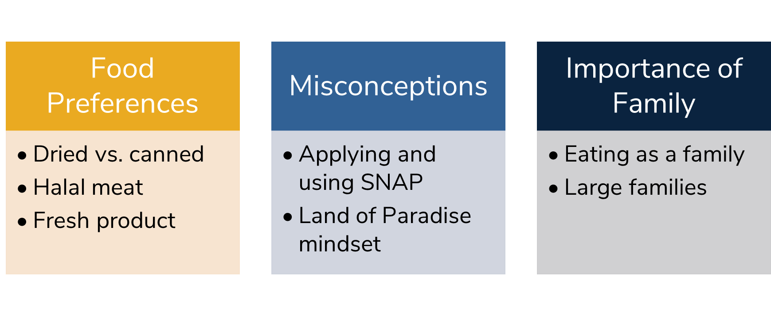
Key Findings

Slide 7
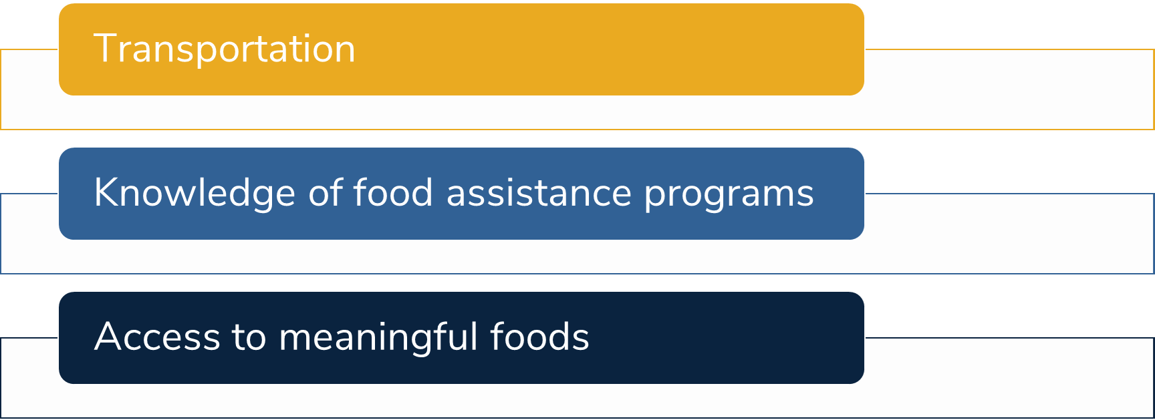
Barriers

Slide 8
Resources
Cultural Food Initiative
Translation Library
Translated Signs
Meaningful Food Lists
How to Use a Food Pantry Videos

Slide 9
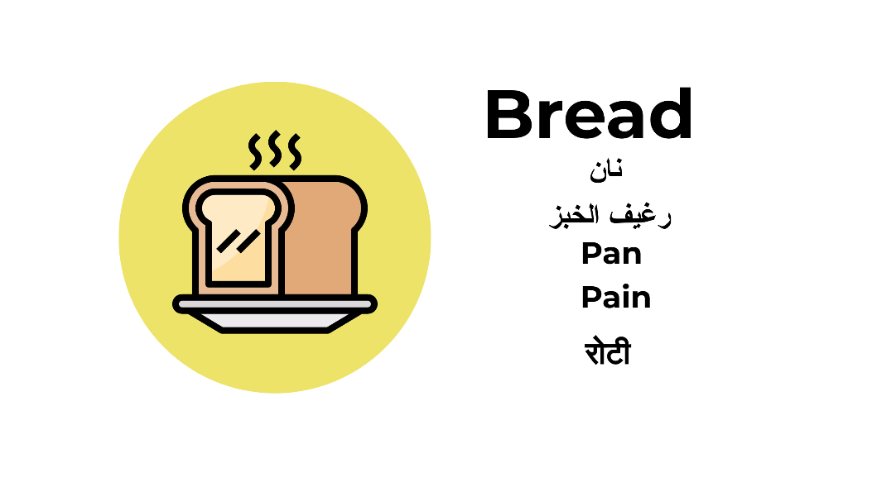
Translated Signs

Slide 10
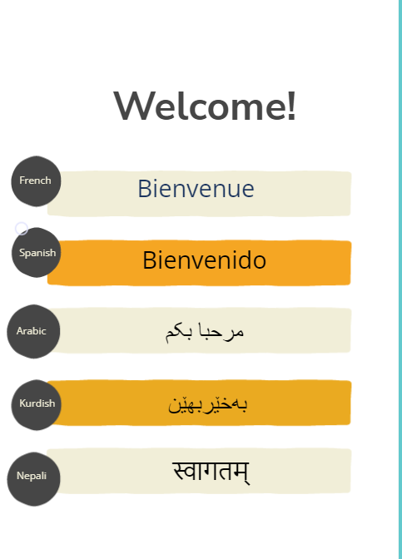
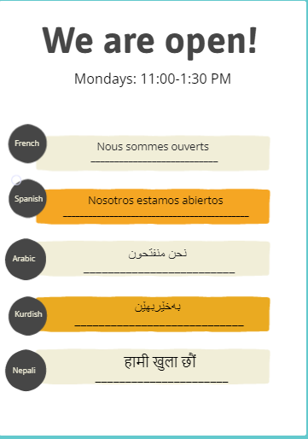
Translated Signs

Slide 11
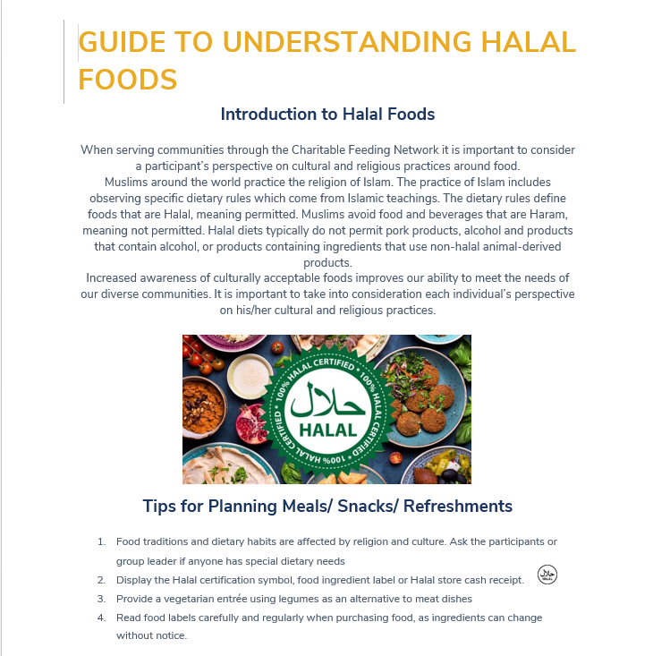
Meaningful Food Resources

Slide 12
Discussion/Activity
In your scenario, how could the pantry make sure they have access and feel welcomed?
What could be ways that hinder creating that sense of belonging in your scenario?
How are you creating a sense of belonging at your agency?
What are ways you could implement and create a sense of belonging if you haven’t started yet?

Slide 13
Things You Can Do!
Listen to the individuals you are serving: focus groups, surveys, 1:1 conversations
Get to know the individuals you are serving - create those relationships rather than just being a transaction
Have different community resources do outreach at your location, or have other resources on hand
Have translated materials for individuals
Recipe cards for certain foods
Food specific food drives
Making your pantry client choice

Slide 14
Questions?
Thank you!

