Slide 1
SWAP, Food Storage & Safety at your Food Pantry

Slide 2
Agenda
Intro to SWAP
Food Storage
Food Safety

Slide 3
SWAP
What is SWAP?
Supporting Wellness at Pantries (SWAP) is a stoplight nutrition ranking system designed to help promote healthy food choices at food banks and food pantries.
The goal of SWAP is to educate your shoppers about foods that can improve their health and to help them make informed decisions.
How does SWAP work?
SWAP ranks foods based on their levels of:
Saturated fat
Sodium (salt)
Sugars
Notes:
This system helps to make identifying healthy options easy.
SWAP ranks foods based on their levels of:
Saturated fat
Sodium (salt)
Sugars
These 3 nutrients are used because they are linked with increased risk of chronic diseases. These chronic diseases can include heart disease, type 2 diabetes, Hypertension (or high blood pressure), Stroke, or Obesity.

Slide 4
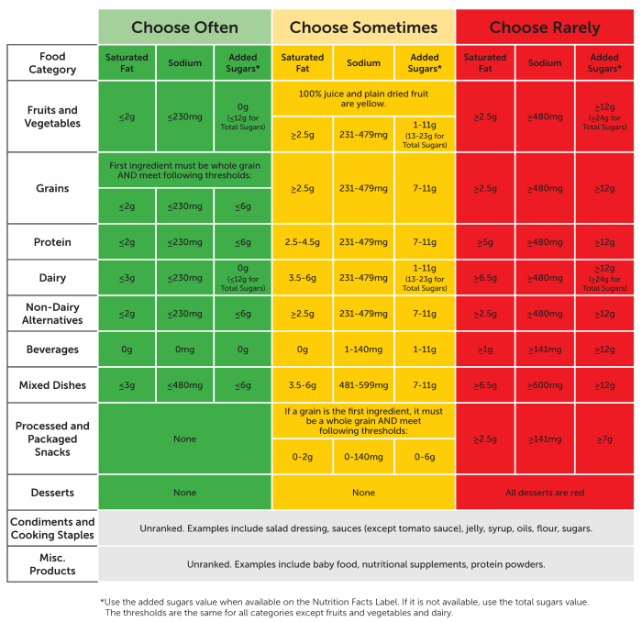
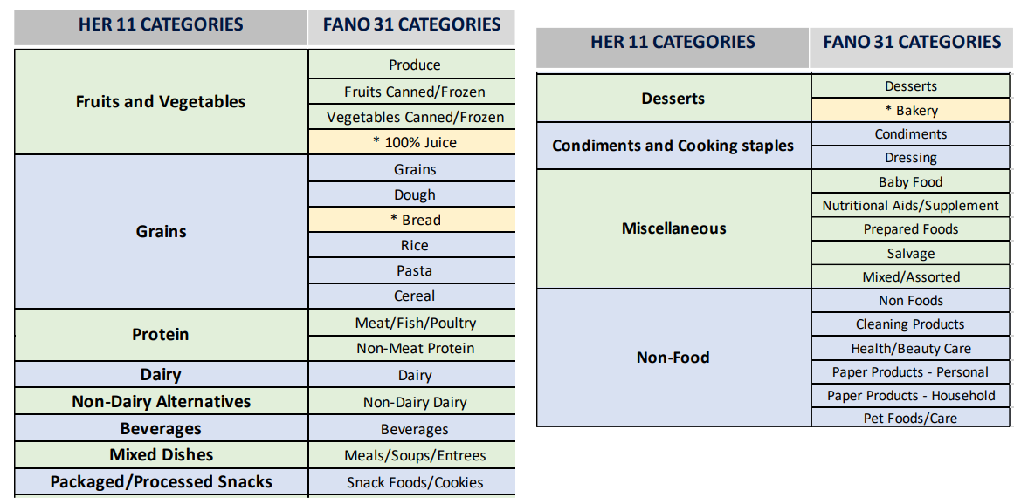
Notes:
SWAP uses 11 food categories when ranking food .
Discuss what we see.
So when ranking food the first step you do is categorize your food, then you use the 3 nutrients levels to rank it green, yellow, or red.

Slide 5
SWAP – cont.
How to use SWAP
The stoplight structure to SWAP categorizes foods as:
Food that is Green (Choose Often)
Food that is Yellow (Choose Sometimes)
Food that is Red (Choose Rarely)
Cooking supplies, condiments and baby food are “Black – Not Ranked”
Non-food items and Misc. Products are “Non-food – No Value”
How can SWAP be implemented?
Notes:
How to use SWAP- Food that is green: Green foods are low in saturated fat, sodium and added sugars and they are foods that support health.
Examples of foods that are green are Fresh Produce (some foods that we have recently had available from the GPFB includes fresh fruit like apples, blueberries, and bananas. vegetables like potatoes and onions.)
Dry goods such as brown rice, whole grain pasta, bread, tortillas, oats or beans.
Dairy products like skim, 1% and 2% milk, cheese, and whole eggs.
Canned produce will also often times fall under the Green category.
Protein (fresh/frozen and often times canned) is also an example- such as chicken, fish fillets, ham.
Think “single or few ingredient foods” as a good rule of thumb, but it’s by no means limited to that.
Food that is Yellow: Yellow foods have medium levels of saturate fat, sodium or added sugars and they are foods that can contribute to good health.
Examples of foods that are yellow are all 100% fruit juice and plain dried fruit.
Some canned goods, like vegetables and proteins, may fall under yellow due to their higher contents of sodium to keep the food quality for a long period of time.
Grains like regular “white” bread, pasta, tortillas, white rice, and some cereals.
Some mixed dishes like boxed mac and cheese or pouch skillet meals.
Most peanut butter is ranked as yellow.
whole milk
Food that is Red: Red foods have high levels of saturated fat, sodium or added sugars and they have limited health benefits.
All desserts are red. This includes ice cream, cookies, cakes, baked goods, etc.
Processed and packaged snacks ( such as chips or crackers and granola or other bars) are red, unless a whole grain is the first ingredient.
Candy and regular soda and non 100% juice, juice drinks high in sugar are red.
a combination of green, yellow, and red is typical and the best recommendation. The idea is that there is greater amounts of green – so more foods from that category. Some foods from yellow and few from red – have a balance! Red is not never – it’s thought to be had as a treat. So an example of shopping for a family may be 5 greens (frozen chicken breasts, fresh apples, potatoes, bag of brown rice, and canned black beans), 3 yellows (orange juice cups, regular tortillas, and peanut butter) and 1 or 2 reds (cookies and ice cream).
How can SWAP be implemented?: The nutrition ranks are added to the GPFB ordering system- we will see examples of this on the coming slides. Pantries can also adapt the SWAP guidelines to in house rank their food. This “SWAP Guide” (show and hand off to be passed around) is used, along with other tools in the SWAP Toolkit, to appropriately rank foods based on their levels of Saturated Fat, Sodium, and Added Sugars.

Slide 6
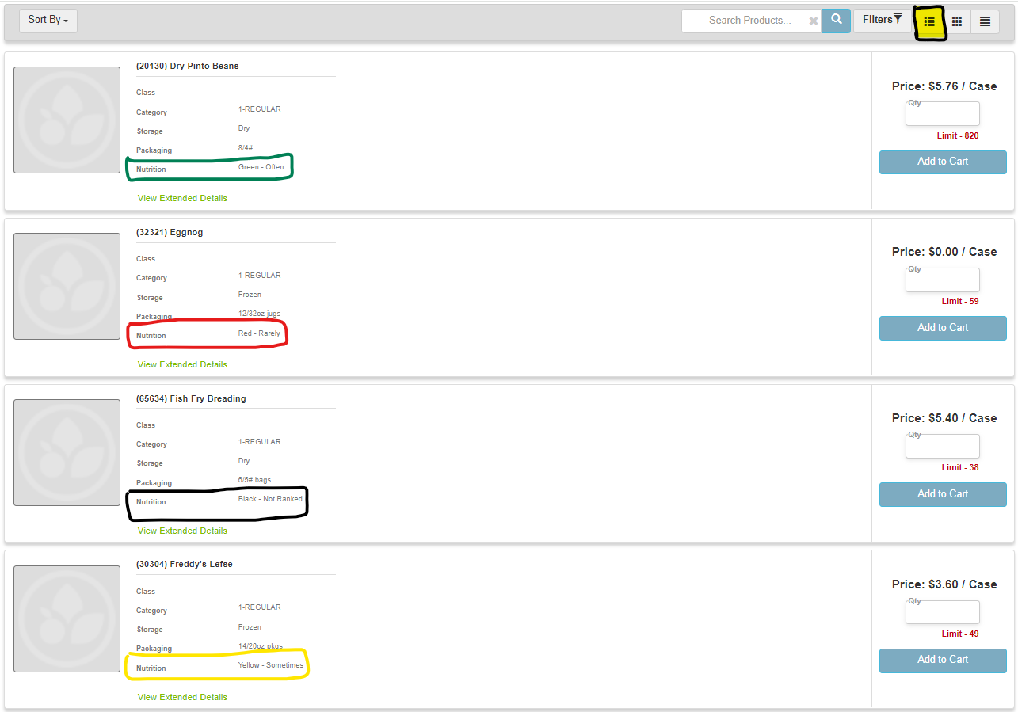
List Display

Slide 7
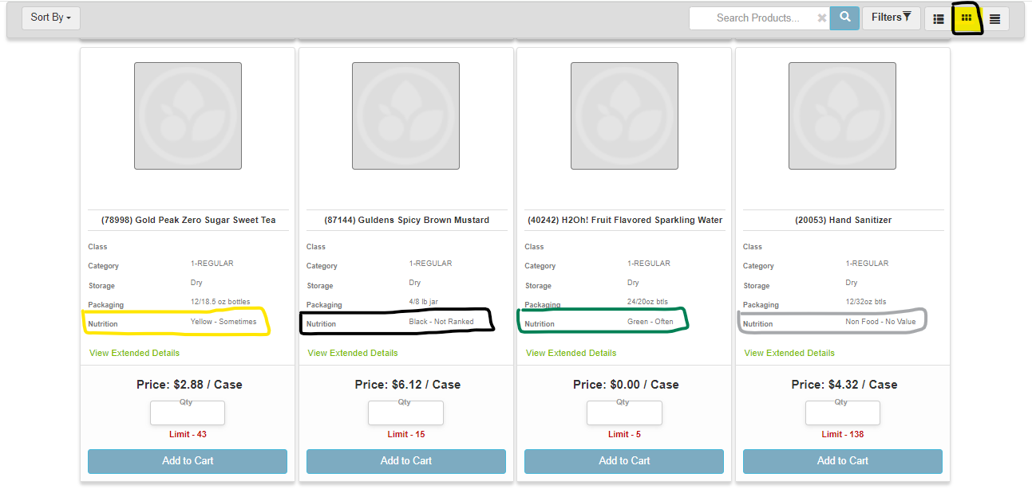
NOTE THAT THE LAST “CONDENSED DISPLAY” WILL NOT SHOW YOU THE NUTRITION VALUE
Tile Display

Slide 8
Food Storage
Preserves the quality.
Preserves the nutritional value.
First in – first out method.
Notes:
Food storage is impactful on the nutrition components of foods, so it is important to store food appropriately.
- Basic food storage rules of thumb I feel you all know can be summed up to: keep dry foods dry, cold foods cold, and frozen foods frozen.
Preserves the quality: without proper food storage, perishable food with spoil fast. Also, harmful bacteria will grow if food is not stored properly, causing foodborne illnesses– this, of course, ruins the quality of your food.
Ways to preserve the quality of foods are to maintain a clean fridge and freezer and do not overcrowd your fridge. Foods need air circulation to maintain their quality- without it spoilage rates increase.
Preserves the nutritional value: Storing food properly will allow foods to keep higher levels of beneficial nutrition.
This is pertinent with Fresh, perishable foods. Use fresh, perishable foods as soon as possible after purchase or delivery.
- Fresh foods have their highest concentration of vitamins and minerals immediately after being harvested- so their nutritional value continues to decrease over time. --- vitamins and minerals will lessen the longer fresh foods go without being consumed.
The first in – first out method: Being sure to rotate food by keeping the older food at the front and back-stocking the new foods ensures that food is consumed at its most high and peak nutrition. It also, for canned/shelf stable goods, ensures that foods with a sooner best or use by date are out the door first. Lessening your spoiled goods.

Slide 9
Food Safety
Things to know:
Many canned and boxed products are safe to eat long after the code date on the container.
Examples of code dates are: Expiration dates, Pack date, Sell-By date, and Use-by or Quality date
While food is safe to eat, it’s nutrients and quality are at their peak the earliest on in their shelf life.
Notes:
Examples of code dates are: do not distribute foods past their expiration date. As far as pack, sell-by, and use by or quality dates go- if the food is handled and stored properly, the food is still safe to eat for sometimes days, months, or even years after the date listed on them BUT keep in mind that the food slowly begins to lose nutrients and the quality lessens over time.
While food is safe to eat, it’s nutrients and quality are at their peak the earliest on in their shelf life: this then aligns with the first in- first out method. Get foods out the door soonest as possible so consumption of the food is had when the food has higher nutrient and quality components.

Slide 10
Agency Partner Best Practices
Tips for building and maintaining a pantry/meal site that is successful now and, in the future.

Slide 11
Agency Partner Best Practices
Tip #1-Don’t Go it Alone! Make sure your bench is deep!
Make sure you have a well-organized team of volunteers for:
Decision making, recordkeeping, food safety, distribution, ordering, statistics entry, funding and food drives, marketing, community building, policies and procedures, succession planning
We recommend 5-15 people working together on your entity’s board and as volunteers to maintain your entity’s operational structure year over year
Partner with a cross-section of community agencies to learn what the neighbors in your community need most so you can be responsive to your community’s changing needs:
Social Service Agencies
Other Pantries or Meal Sites
Schools or Senior Centers
Healthcare Entities

Slide 12
Agency Partner Best Practices
Tip #2-Be curious about who you serve and offer choice
Learn about your community
What is your community’s population? How many are living at or below the poverty line?
Census.gov Learn what the need is in your community and what are the changes in the landscape of your community (younger families, seniors, etc.)
If you are in a smaller community, do you draw community members living elsewhere in the county to utilize your site?
Be flexible to be equitable; based on household/family size, offer food based on the number of individuals served versus a fixed amount of food
Offer more frequent, weekend, or evening access hours
Offer a choice model which is equivalent to grocery store shopping; neighbors get to shop the foods that they and their households will utilize based on preference, allergies, and nutrition

Slide 13
Agency Partner Best Practices
Tip #3-Order the right amount for your site; seek to grow and diversify offerings
Utilize your historical statistics to plan; use these statistics to make the case when writing grants or planning for funding from your local board
Example:
100 Households served per month x each household receives an average of 30 lbs of food. How much should this pantry order per month?
Answer: 3,000 pounds of food per month (more to have additional on hand)
Partner with local entities to source more food outside of the monthly GPFB deliveries:
Farmers that donate produce in season
Retail Rescue-get connected with a local grocery store for more
Hold food drives asking for specific highly desired items:
Peanut Butter Drive, Diaper Drive, Canned Chicken Drive, etc.
Include recipes with items at your site to empower neighbors to utilize a greater variety of foods

Slide 14
Agency Partner Best Practices
Tip #4-Recruit Volunteers and Succession Plan
Document your processes at your site so other volunteers can step in to assist you!
Invite additional volunteers in (high school students, families, etc. faith community, etc.) to learn about your pantry operations and become a volunteer on a regular basis.
Make plans for when you or your current team of volunteers are no longer operating the site. Who will continue to keep your site running? Give your successors the gift of a well thought out plan with which to keep your site operational
Keep meticulous records and cross-train your volunteers to carry out ordering, distribution, statistics entry, food safety, and records management

Slide 15
Agency Partner Best Practices
Tip #5-Ask for help and support from GPFB Staff and other Agency Partners!
Our shared goal is ending hunger together!
Invite your neighbors to utilize the additional offerings of support including SNAP Application Assistance and the Senior Food Box Program
Utilize the grant writing assistance toolkit to search for additional funding to keep your site thriving and operational
Learn if there are additional offerings like the Backpack Program, School Pantry Program, and Youth Summer Meals that you can offer to your neighbors
Connect with other Agency Partners to learn what works and doesn’t work for them and learn from one another

Slide 16
Thank You for your tireless work together with us to End Hunger!
Q & A
Visit our booth during the “Food Bank Fair: 1-2pm” for handouts and more information on SWAP!

